Slide 1



Automated Reasoning about Software ($67532$)
Guy Katz
Lecture $7$: DPLL(T) December $9$^{th}, $2019$

Slide 2
Acknowledgements
Some of the material presented has been borrowed from slides by David Dill, Isil Dillig, Gera Weiss, Clark Barrett, Alex Aiken, Mooly Sagiv, Sagar Chaki and Ofer Strichman

Slide 3
Recap
SMT solvers: general purpose reasoning engines
Their language: first order logic (FOL)
Theories: a way to restrict FOL, to give special meaning to symbols
Theories of interest: arithmetic, arrays, bit vectors
The lazy approach
Combine SAT engine with theory solvers
SAT engine solves a Boolean abstraction
Theory solvers guide the SAT engine

Slide 4
SMT: Main Challenges
How to solve conjunctions of literals in a theory?
Use theory solvers
How to combine solvers for multiple theories
The Nelson-Oppen method
How to combine a theory solver and a SAT solver
The DPLL(T) framework

Slide 5
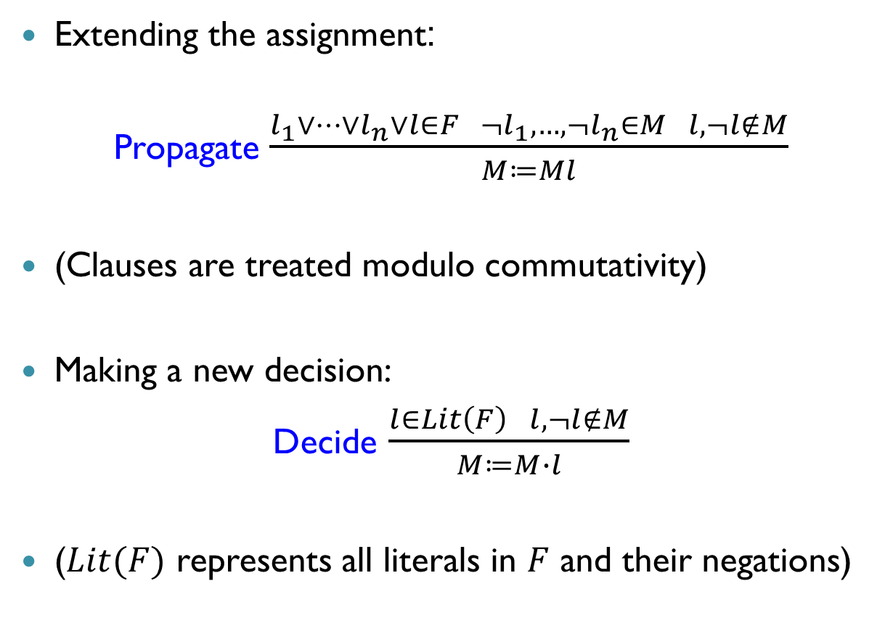
Abstract DPLL: Transition Rules
Extending the assignment:
Propagate $\frac{l_{1}∨…∨l_{n}∨l∈F ¬l_{1},…, ¬l_{n}∈M l,¬l∉M}{M≔Ml}$
(Clauses are treated modulo commutativity)
Making a new decision:
Decide $\frac{l∈Lit\left(F\right) l,¬l∉M}{M≔M∙l}$
($Lit(F)$ represents all literals in $F$ and their negations)

Slide 6
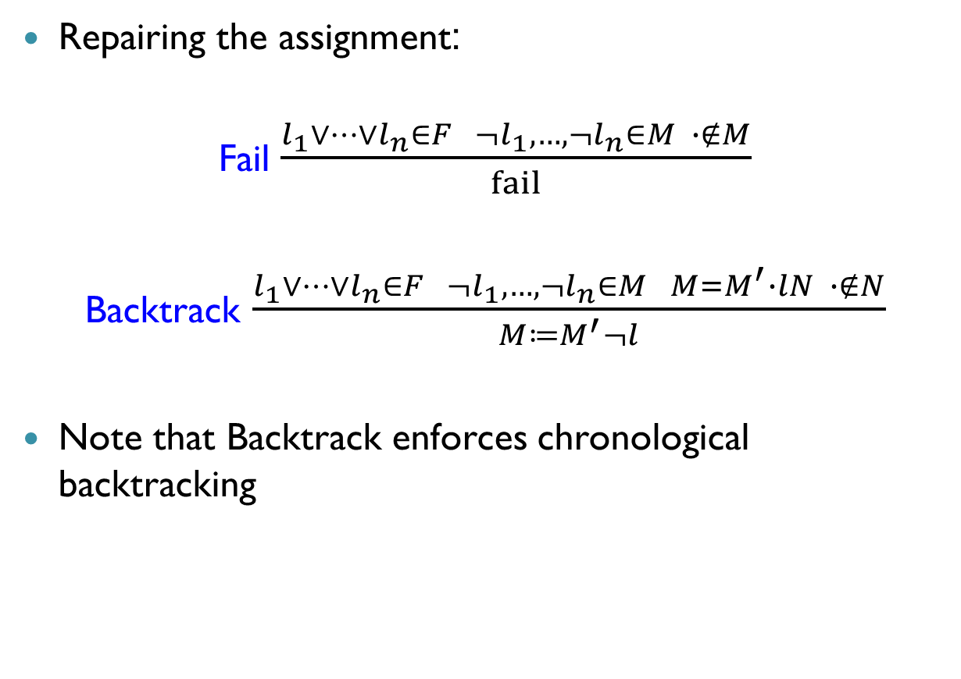
DPLL Transition Rules (cnt’d)
Repairing the assignment:
Fail $\frac{l_{1}∨…∨l_{n}∈F ¬l_{1},…, ¬l_{n}∈M ∙∉M}{fail}$
Backtrack $\frac{l_{1}∨…∨l_{n}∈F ¬l_{1},…, ¬l_{n}∈M M=M^{′}∙lN ∙∉N}{M≔M^{′}¬l}$
Note that Backtrack enforces chronological backtracking

Slide 7

From DPLL to CDCL
Recall: conflict analysis is an important extension to DPLL
To support this, we add a third component $C$ to states, whose value is either no, or a conflict clause

Slide 8
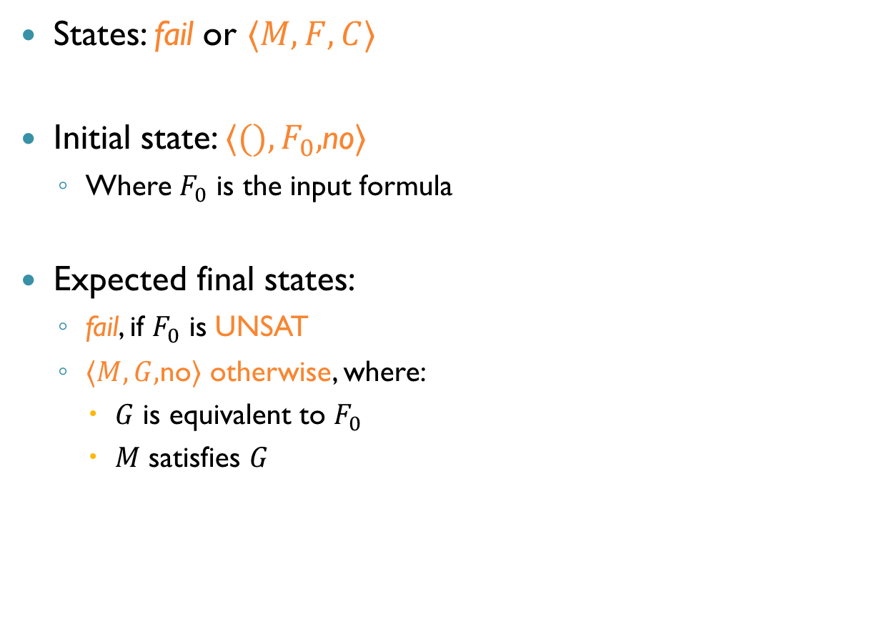
From DPLL to CDCL (cnt’d)
States: fail or $〈M,F,C〉$
Initial state: $〈(),F_{0},$no$〉$
Where $F_{0}$ is the input formula
Expected final states:
fail, if $F_{0}$ is UNSAT
$〈M,G,$no$〉$ otherwise, where:
$G$ is equivalent to $F_{0}$
$M$ satisfies $G$

Slide 9
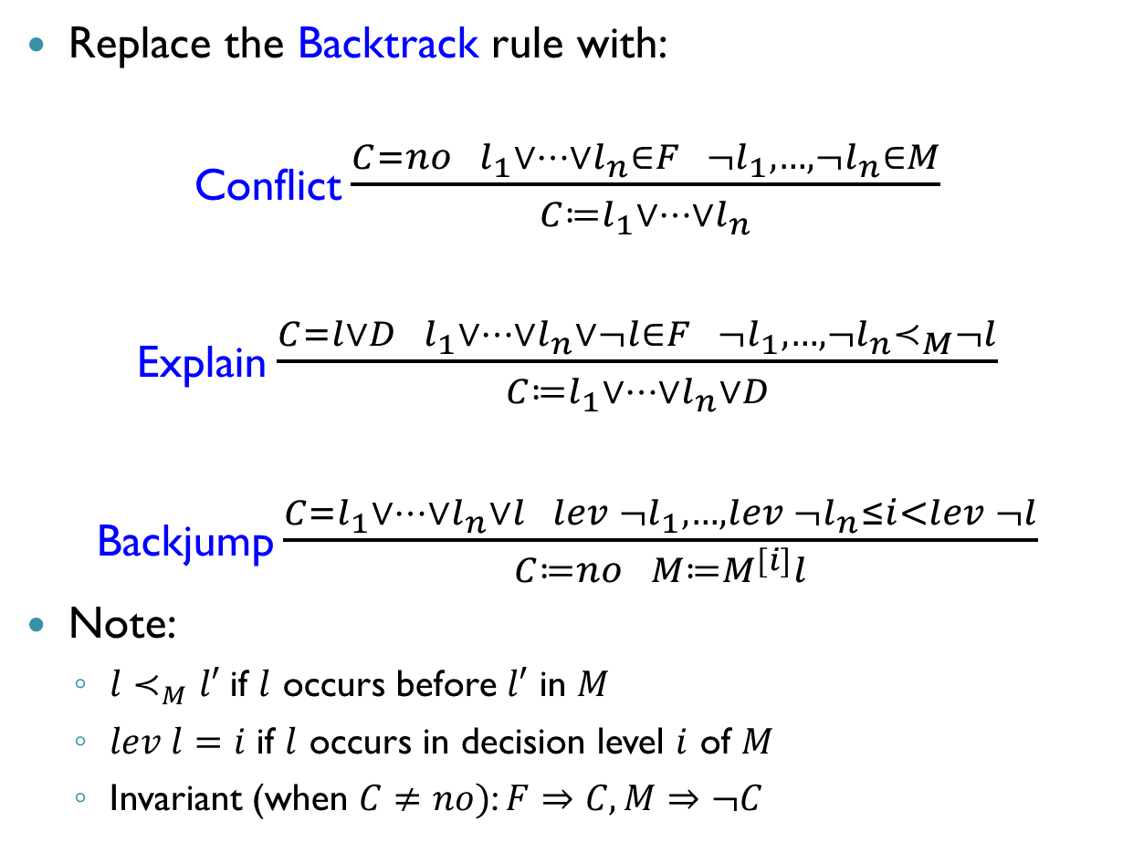
From DPLL to CDCL (cnt’d)
Replace the Backtrack rule with:
Conflict $\frac{C=no l_{1}∨…∨l_{n}∈F ¬l_{1},…, ¬l_{n}∈M}{C≔l_{1}∨…∨l_{n}}$
Explain $\frac{C=l∨D l_{1}∨…∨l_{n}∨¬l∈F ¬l_{1},…, ¬l_{n}≺_{M}¬l}{C≔l_{1}∨…∨l_{n}∨D}$
Backjump $\frac{C=l_{1}∨…∨l_{n}∨l lev ¬l_{1},…, lev ¬l_{n}≤i<lev ¬l}{C≔no M≔M^{[i]}l}$
Note:
$l≺_{M}l′$ if $l$ occurs before $l′$ in $M$
$lev l=i$ if $l$ occurs in decision level $i$ of $M$
Invariant (when $C≠no)$: $F⇒C, M⇒¬C$

Slide 10

From DPLL to CDCL (cnt’d)
Modify the Fail rule:
Fail $\frac{C≠no ∙∉M}{fail}$

Slide 11


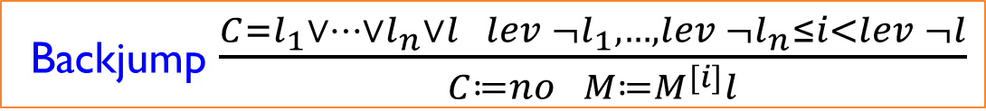
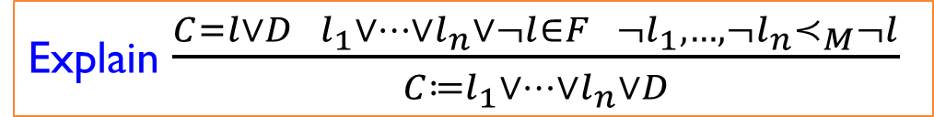
Example (Partial)
$$F=\left\{1, ¬1∨2, ¬3∨4, ¬5∨¬6, ¬1∨¬5∨7, ¬2∨¬5∨6∨¬7\right\}$$
$$M$$ | $$F$$ | $$C$$ | Rule
 | $$F$$ | No
$$1$$ | $$F$$ | No | Propagate
$$1 2$$ | $$F$$ | No | Propagate
$$1 2∙3$$ | $$F$$ | No | Decide
$$1 2∙3 4$$ | $$F$$ | No | Propagate
$$1 2∙3 4∙5$$ | $$F$$ | No | Decide
$$1 2∙3 4∙5 ¬6$$ | $$F$$ | No | Propagate
$$1 2∙3 4∙5 ¬6 7$$ | $$F$$ | No | Propagate
$$1 2∙3 4∙5 ¬6 7$$ | $$F$$ | $$¬2∨¬5∨6∨¬7$$ | Conflict
$$1 2∙3 4∙5 ¬6 7$$ | $$F$$ | $$¬1∨¬2∨¬5∨6$$ | Explain ($¬1∨¬5∨7)$
$$1 2∙3 4∙5 ¬6 7$$ | $$F$$ | $$¬1∨¬2∨¬5$$ | Explain ($¬5∨¬6)$
$$1 2 ¬5$$ | $$F$$ | No | Backjump
$$1 2 ¬5∙3$$ | $$F$$ | No | Decide
Explain $\frac{C=l∨D l_{1}∨…∨l_{n}∨¬l∈F ¬l_{1},…, ¬l_{n}≺_{M}¬l}{C≔l_{1}∨…∨l_{n}∨D}$
Backjump $\frac{C=l_{1}∨…∨l_{n}∨l lev ¬l_{1},…, lev ¬l_{n}≤i<lev ¬l}{C≔no M≔M^{[i]}l}$

Slide 12
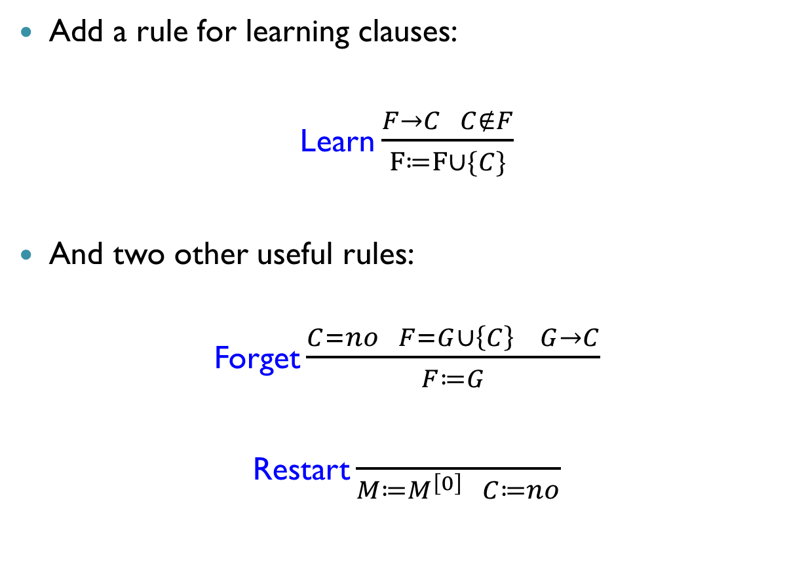
From DPLL to CDCL (cnt’d)
Add a rule for learning clauses:
Learn $\frac{F→C C∉F}{F≔F∪\{C\}}$
And two other useful rules:
Forget $\frac{C=no F=G∪\left\{C\right\} G→C}{F≔G}$
Restart $\frac{ }{M≔M^{\left[0\right]} C≔no}$

Slide 13
From DPLL to CDCL (cnt’d)
Current CDCL solvers implement the rules:
Propagate, Decide
Conflict, Explain, Backjump
Learn, Forget, Restart
Basic DPLL:
Propagate, Decide, Conflict, Explain, Backjump

Slide 14
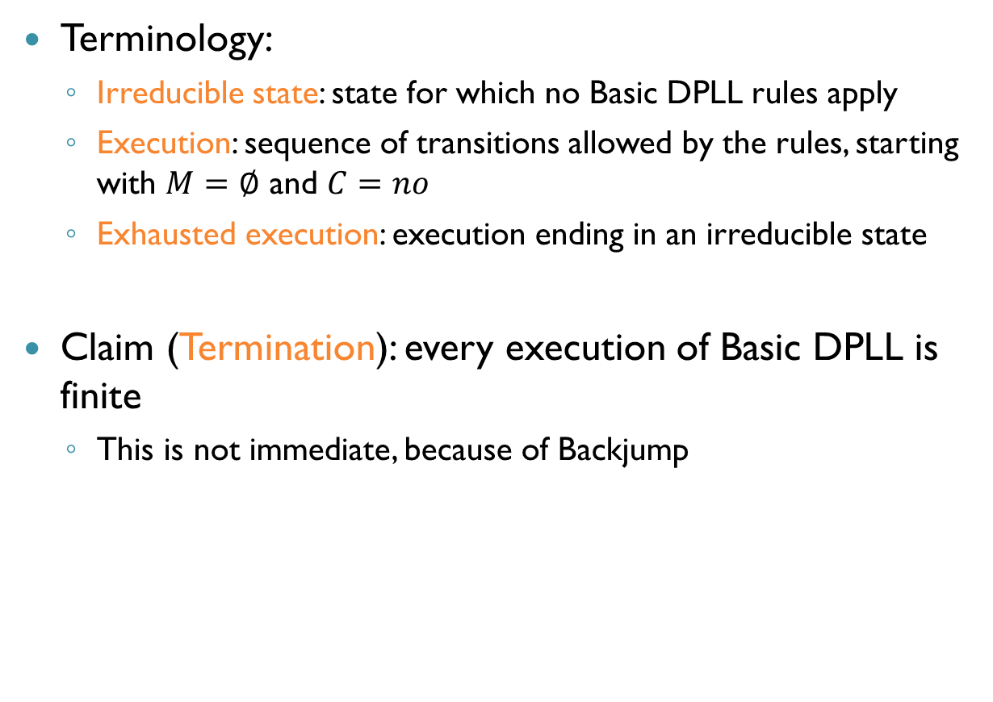
Correctness of Basic DPLL
Terminology:
Irreducible state: state for which no Basic DPLL rules apply
Execution: sequence of transitions allowed by the rules, starting with $M=∅$ and $C=no$
Exhausted execution: execution ending in an irreducible state
Claim (Termination): every execution of Basic DPLL is finite
This is not immediate, because of Backjump

Slide 15
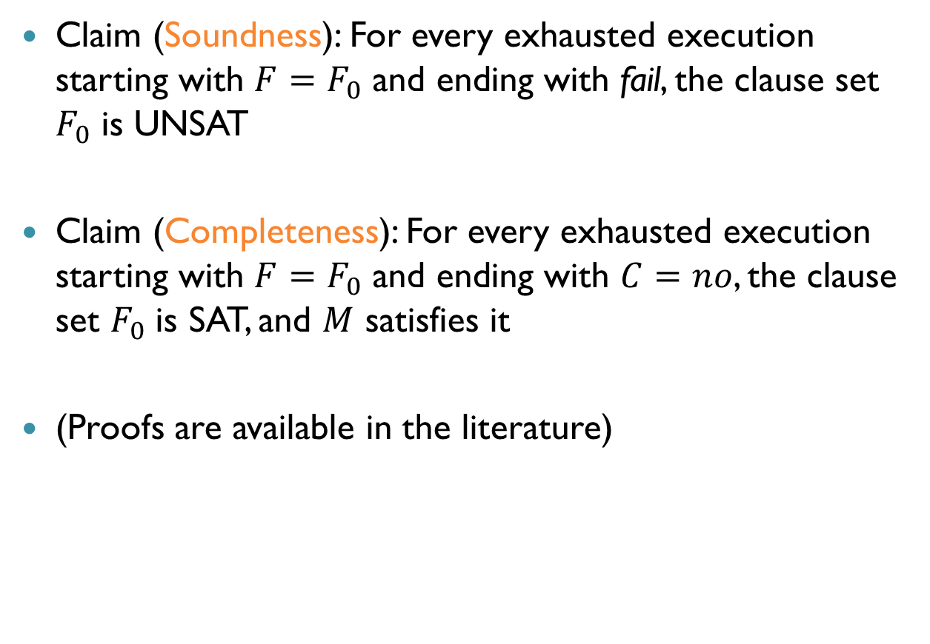
Correctness of Basic DPLL (cnt’d)
Claim (Soundness): For every exhausted execution starting with $F=F_{0}$ and ending with fail, the clause set $F_{0}$ is UNSAT
Claim (Completeness): For every exhausted execution starting with $F=F_{0}$ and ending with $C=no$, the clause set $F_{0}$ is SAT, and $M$ satisfies it
(Proofs are available in the literature)

Slide 16
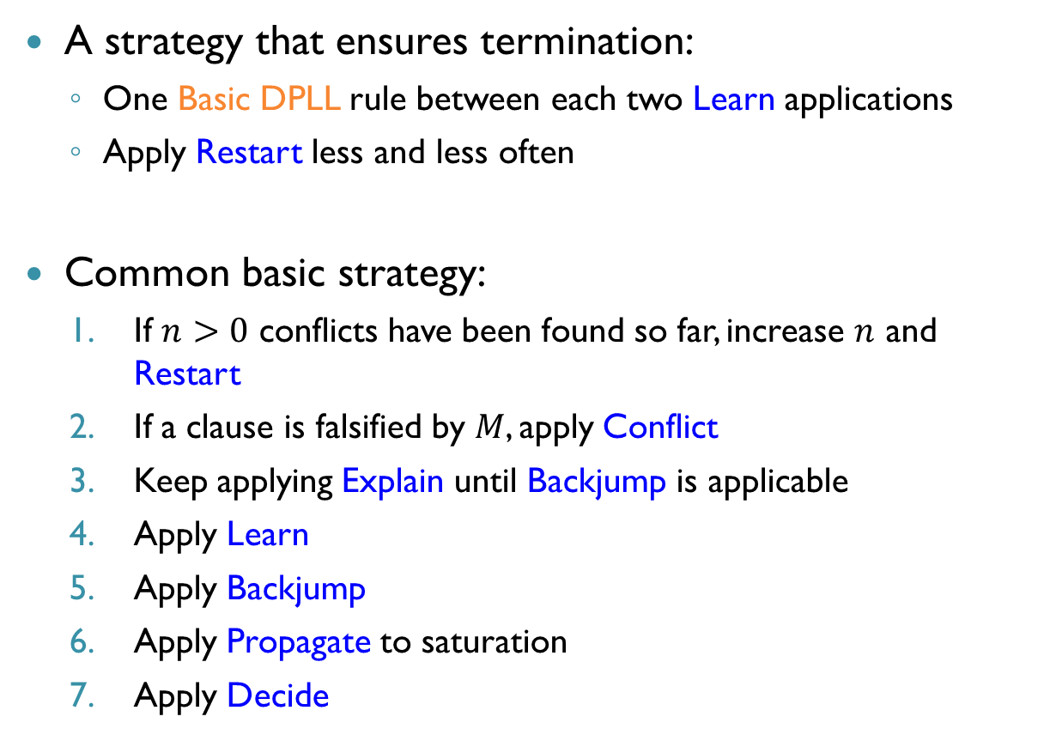
DPLL: Strategies
A strategy that ensures termination:
One Basic DPLL rule between each two Learn applications
Apply Restart less and less often
Common basic strategy:
If $n>0$ conflicts have been found so far, increase $n$ and Restart
If a clause is falsified by $M$, apply Conflict
Keep applying Explain until Backjump is applicable
Apply Learn
Apply Backjump
Apply Propagate to saturation
Apply Decide

Slide 17
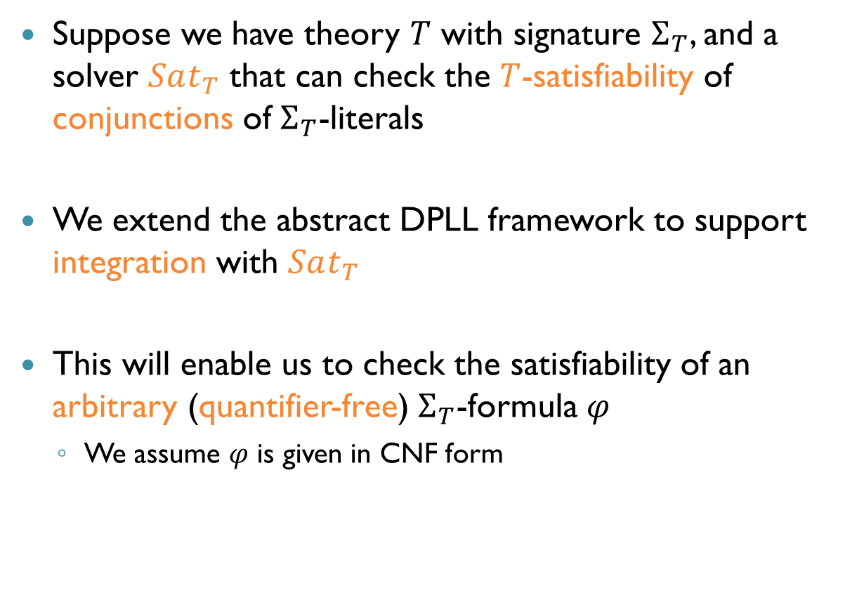
From SAT to SMT
Suppose we have theory $T$ with signature $Σ_{T}$, and a solver $Sat_{T}$ that can check the $T$-satisfiability of conjunctions of $Σ_{T}$-literals
We extend the abstract DPLL framework to support integration with $Sat_{T}$
This will enable us to check the satisfiability of an arbitrary (quantifier-free) $Σ_{T}$-formula $φ$
We assume $φ$ is given in CNF form

Slide 18
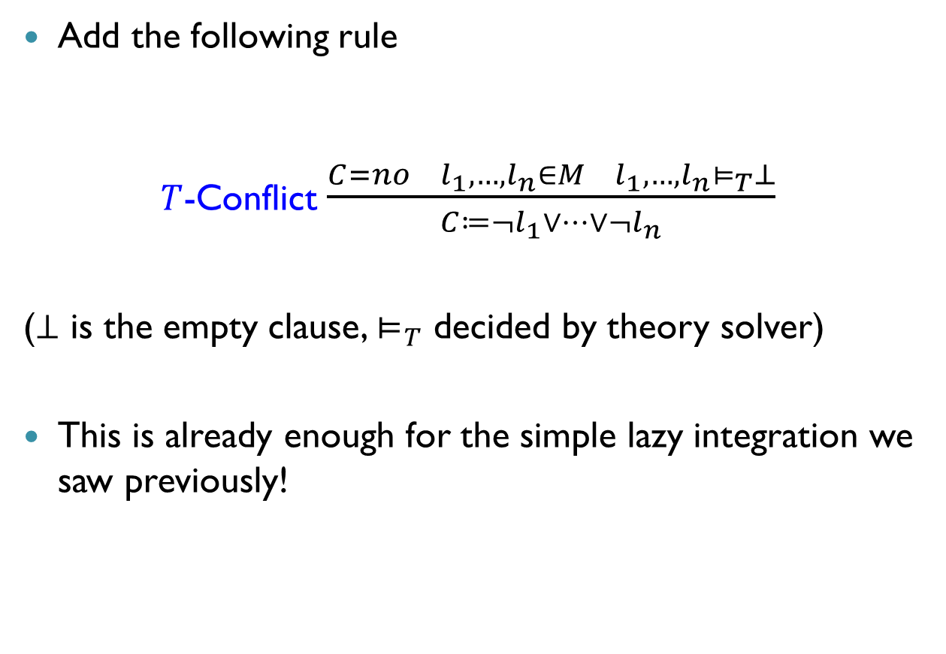
DPLL(T)
Add the following rule
$T$-Conflict $\frac{C=no l_{1},…, l_{n}∈M l_{1},…, l_{n}⊨_{T}⊥}{C≔¬l_{1}∨…∨¬l_{n}}$
($⊥$ is the empty clause, $⊨_{T}$ decided by theory solver)
This is already enough for the simple lazy integration we saw previously!

Slide 19

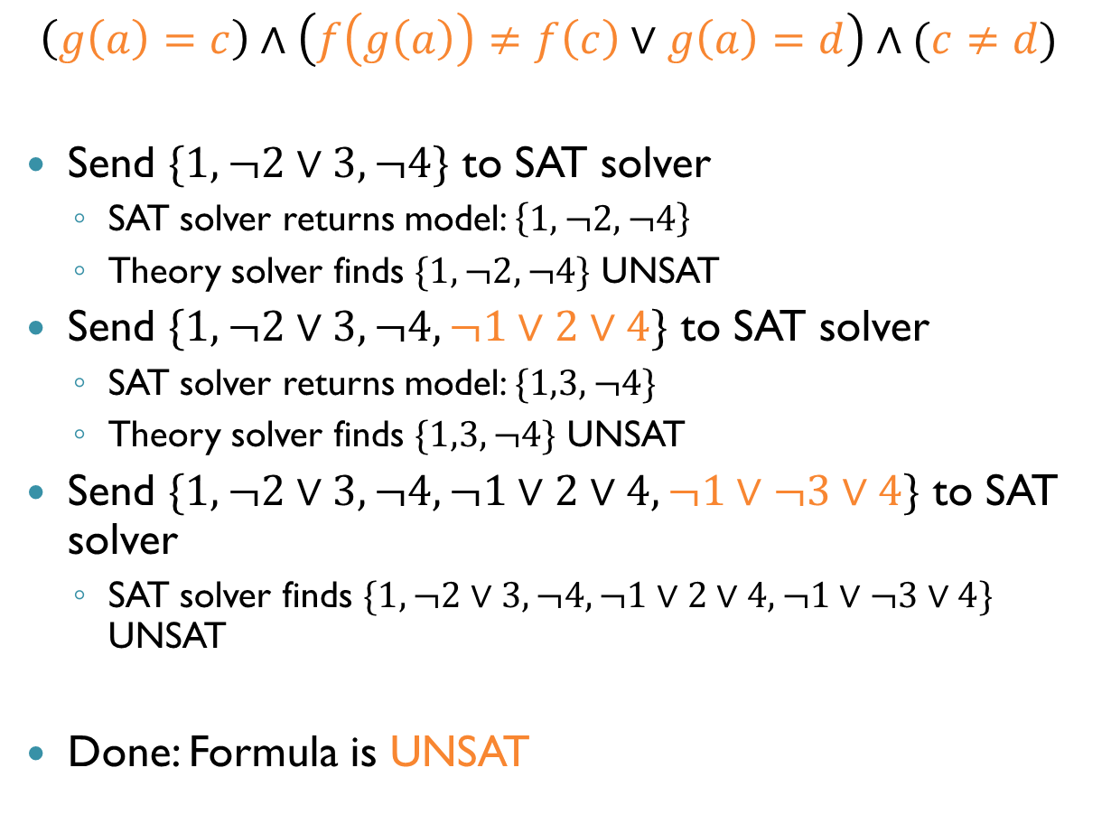



Recall: UF Example
$$\left(g\left(a\right)=c\right)∧\left(f\left(g\left(a\right)\right)≠f\left(c\right)∨g\left(a\right)=d\right)∧(c≠d)$$
Send $\{1,¬2∨3,¬4\}$ to SAT solver
SAT solver returns model: $\left\{1,¬2,¬4\right\}$
Theory solver finds $\{1,¬2,¬4\}$ UNSAT
Send $\{1,¬2∨3,¬4,¬1∨2∨4\}$ to SAT solver
SAT solver returns model: $\{1,3,¬4\}$
Theory solver finds $\{1,3,¬4\}$ UNSAT
Send $\{1,¬2∨3,¬4,¬1∨2∨4,¬1∨¬3∨4\}$ to SAT solver
SAT solver finds $\{1,¬2∨3,¬4,¬1∨2∨4,¬1∨¬3∨4\}$ UNSAT
Done: Formula is UNSAT
$$x_{1}$$
$$¬x_{2}$$
$$x_{3}$$
$$¬x_{4}$$

Slide 20
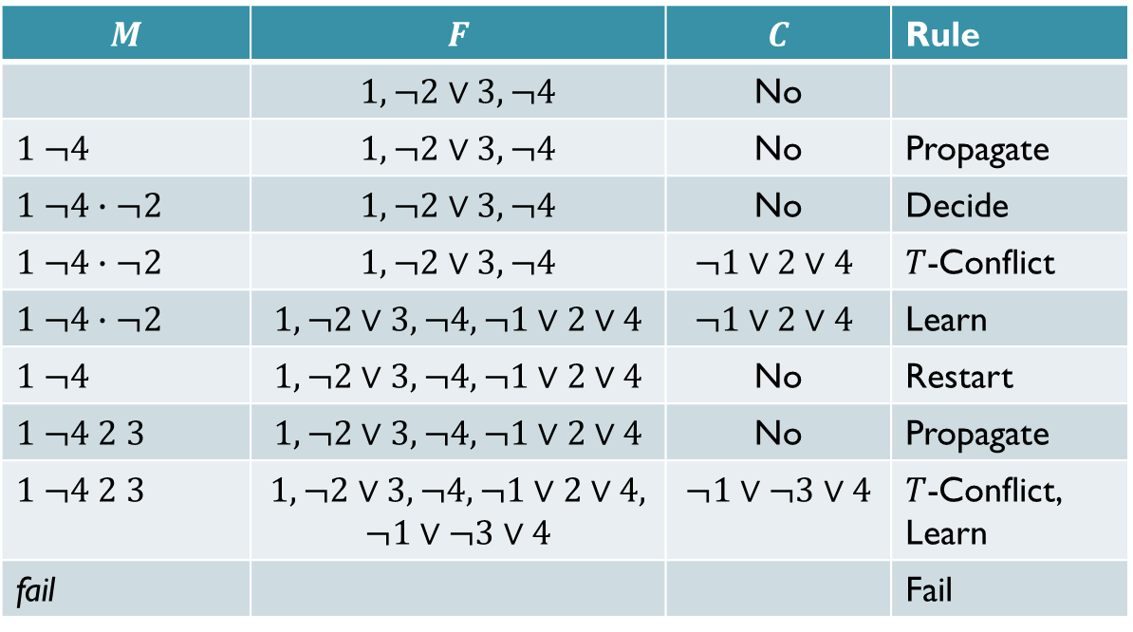

UF Example, Lazy Approach
$$\left(g\left(a\right)=c\right)∧\left(f\left(g\left(a\right)\right)≠f\left(c\right)∨g\left(a\right)=d\right)∧(c≠d)$$
$$x_{1}$$
$$¬x_{2}$$
$$x_{3}$$
$$¬x_{4}$$
$$M$$ | $$F$$ | $$C$$ | Rule
 | $$1, ¬2∨3, ¬4$$ | No
$$1 ¬4$$ | $$1, ¬2∨3, ¬4$$ | No | Propagate
$$1 ¬4∙¬2$$ | $$1, ¬2∨3, ¬4$$ | No | Decide
$$1 ¬4∙¬2$$ | $$1, ¬2∨3, ¬4$$ | $$¬1∨2∨4$$ | $T$-Conflict
$$1 ¬4∙¬2$$ | $$1, ¬2∨3, ¬4,¬1∨2∨4$$ | $$¬1∨2∨4$$ | Learn
$$1 ¬4$$ | $$1, ¬2∨3, ¬4,¬1∨2∨4$$ | No | Restart
$$1 ¬4 2 3$$ | $$1, ¬2∨3, ¬4,¬1∨2∨4$$ | No | Propagate
$$1 ¬4 2 3$$ | $$1, ¬2∨3, ¬4,¬1∨2∨4,$$ $$¬1∨¬3∨4$$ | $$¬1∨¬3∨4$$ | $T$-Conflict, Learn
fail |  |  | Fail

Slide 21
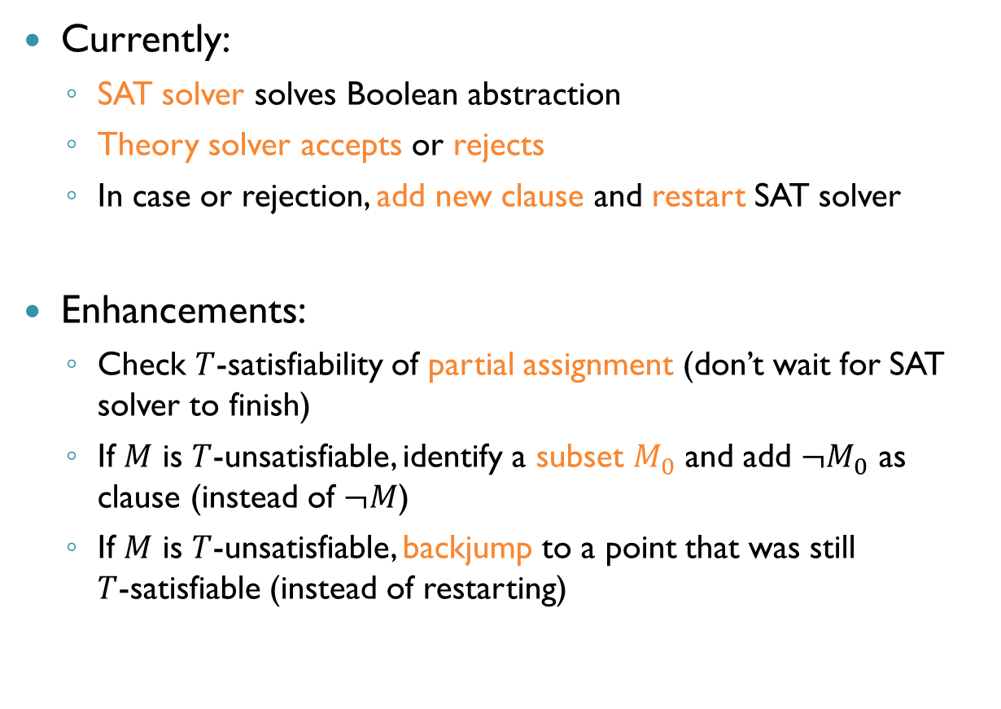
More Efficient Laziness?
Currently:
SAT solver solves Boolean abstraction
Theory solver accepts or rejects
In case or rejection, add new clause and restart SAT solver
Enhancements:
Check $T$-satisfiability of partial assignment (don’t wait for SAT solver to finish)
If $M$ is $T$-unsatisfiable, identify a subset $M_{0}$ and add $¬M_{0}$ as clause (instead of $¬M$)
If $M$ is $T$-unsatisfiable, backjump to a point that was still $T$-satisfiable (instead of restarting)

Slide 22
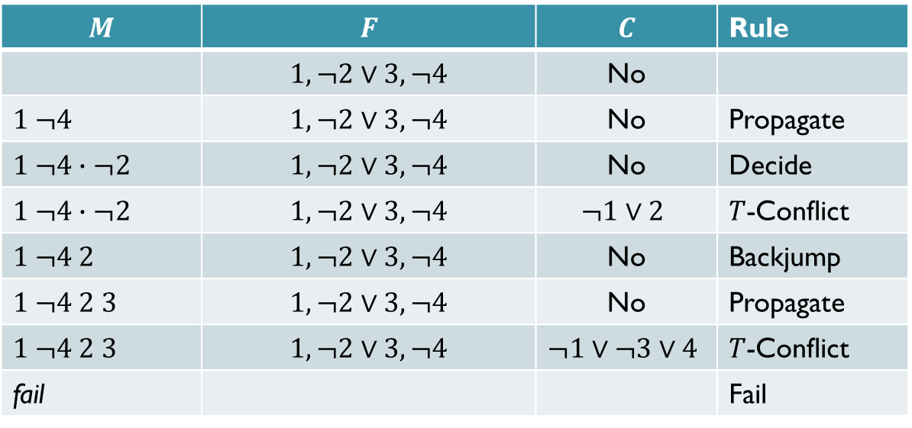
UF Example, Revisited
$$\left(g\left(a\right)=c\right)∧\left(f\left(g\left(a\right)\right)≠f\left(c\right)∨g\left(a\right)=d\right)∧(c≠d)$$
$$x_{1}$$
$$¬x_{2}$$
$$x_{3}$$
$$¬x_{4}$$
$$M$$ | $$F$$ | $$C$$ | Rule
 | $$1, ¬2∨3, ¬4$$ | No
$$1 ¬4$$ | $$1, ¬2∨3, ¬4$$ | No | Propagate
$$1 ¬4∙¬2$$ | $$1, ¬2∨3, ¬4$$ | No | Decide
$$1 ¬4∙¬2$$ | $$1, ¬2∨3, ¬4$$ | $$¬1∨2$$ | $T$-Conflict
$$1 ¬4 2$$ | $$1, ¬2∨3, ¬4$$ | No | Backjump
$$1 ¬4 2 3$$ | $$1, ¬2∨3, ¬4$$ | No | Propagate
$$1 ¬4 2 3$$ | $$1, ¬2∨3, ¬4$$ | $$¬1∨¬3∨4$$ | $T$-Conflict
fail |  |  | Fail

Slide 23
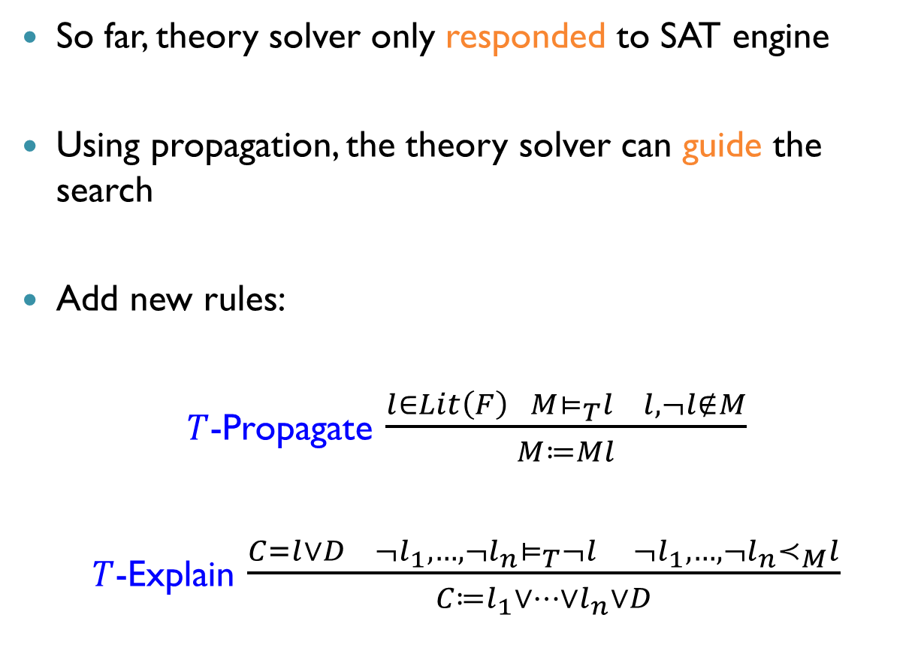
Theory Propagation
So far, theory solver only responded to SAT engine
Using propagation, the theory solver can guide the search
Add new rules:
$T$-Propagate $\frac{l∈Lit\left(F\right) M⊨_{T}l l,¬l∉M}{M≔Ml}$
$T$-Explain $\frac{C=l∨D ¬l_{1},…,¬l_{n}⊨_{T}¬l ¬l_{1},…, ¬l_{n}≺_{M}l}{C≔l_{1}∨…∨l_{n}∨D}$

Slide 24
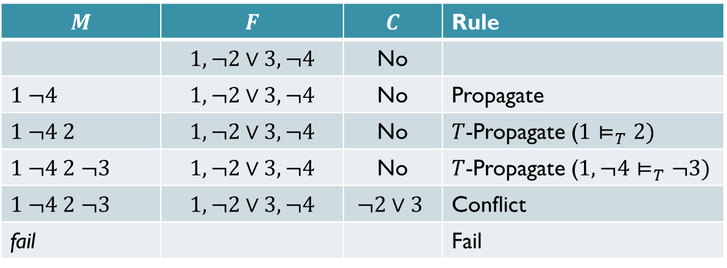

UF Example, Revisited Again
$$\left(g\left(a\right)=c\right)∧\left(f\left(g\left(a\right)\right)≠f\left(c\right)∨g\left(a\right)=d\right)∧(c≠d)$$
$T$-propagation eliminates the search completely in this example!
$$x_{1}$$
$$¬x_{2}$$
$$x_{3}$$
$$¬x_{4}$$
$$M$$ | $$F$$ | $$C$$ | Rule
 | $$1, ¬2∨3, ¬4$$ | No
$$1 ¬4$$ | $$1, ¬2∨3, ¬4$$ | No | Propagate
$$1 ¬4 2$$ | $$1, ¬2∨3, ¬4$$ | No | $T$-Propagate ($1⊨_{T}2)$
$$1 ¬4 2 ¬3$$ | $$1, ¬2∨3, ¬4$$ | No | $T$-Propagate ($1,¬4⊨_{T}¬3)$
$$1 ¬4 2 ¬3$$ | $$1, ¬2∨3, ¬4$$ | $$¬2∨3$$ | Conflict
fail |  |  | Fail

Slide 25
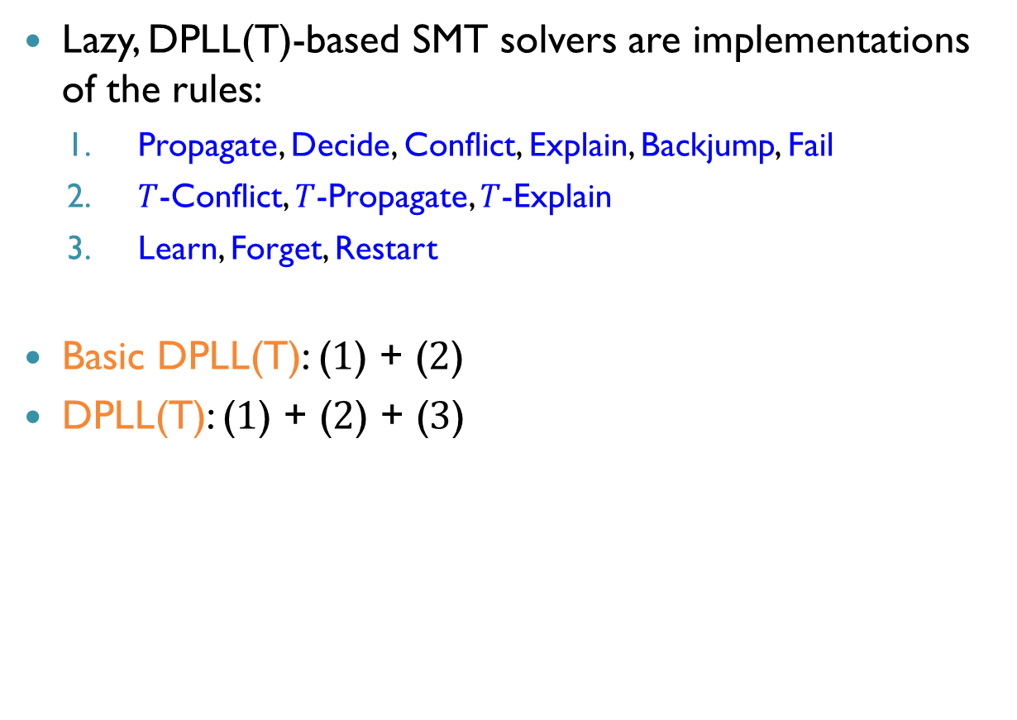
DPLL(T)
Lazy, DPLL(T)-based SMT solvers are implementations of the rules:
Propagate, Decide, Conflict, Explain, Backjump, Fail
$T$-Conflict, $T$-Propagate, $T$-Explain
Learn, Forget, Restart
Basic DPLL(T): ($1$) + ($2$)
DPLL(T): ($1$) + ($2$) + ($3$)

Slide 26
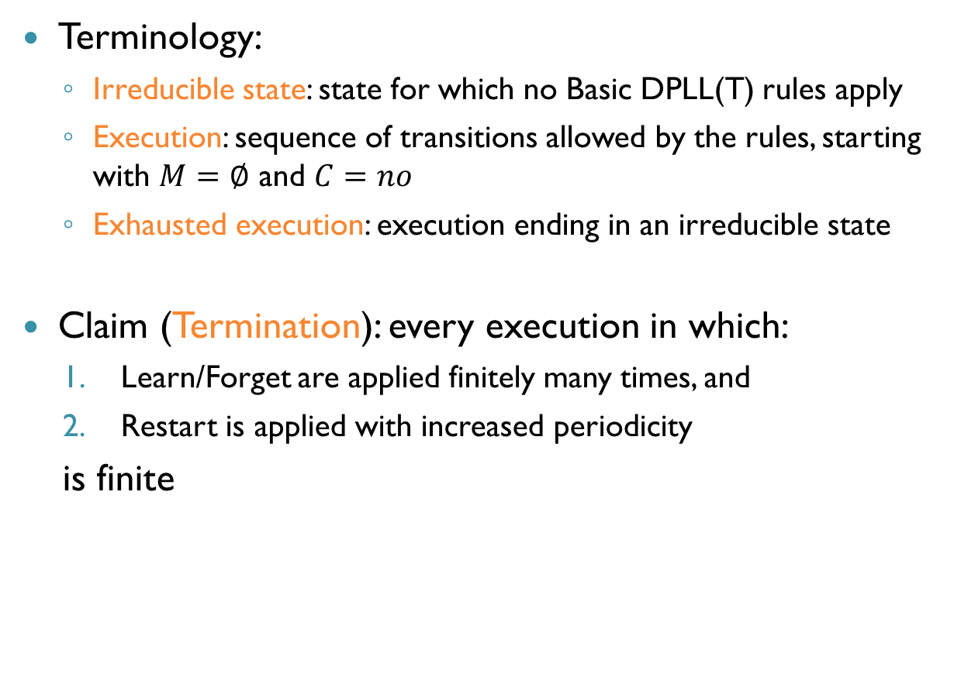
Correctness of DPLL(T)
Terminology:
Irreducible state: state for which no Basic DPLL(T) rules apply
Execution: sequence of transitions allowed by the rules, starting with $M=∅$ and $C=no$
Exhausted execution: execution ending in an irreducible state
Claim (Termination): every execution in which:
Learn/Forget are applied finitely many times, and
Restart is applied with increased periodicity
is finite

Slide 27
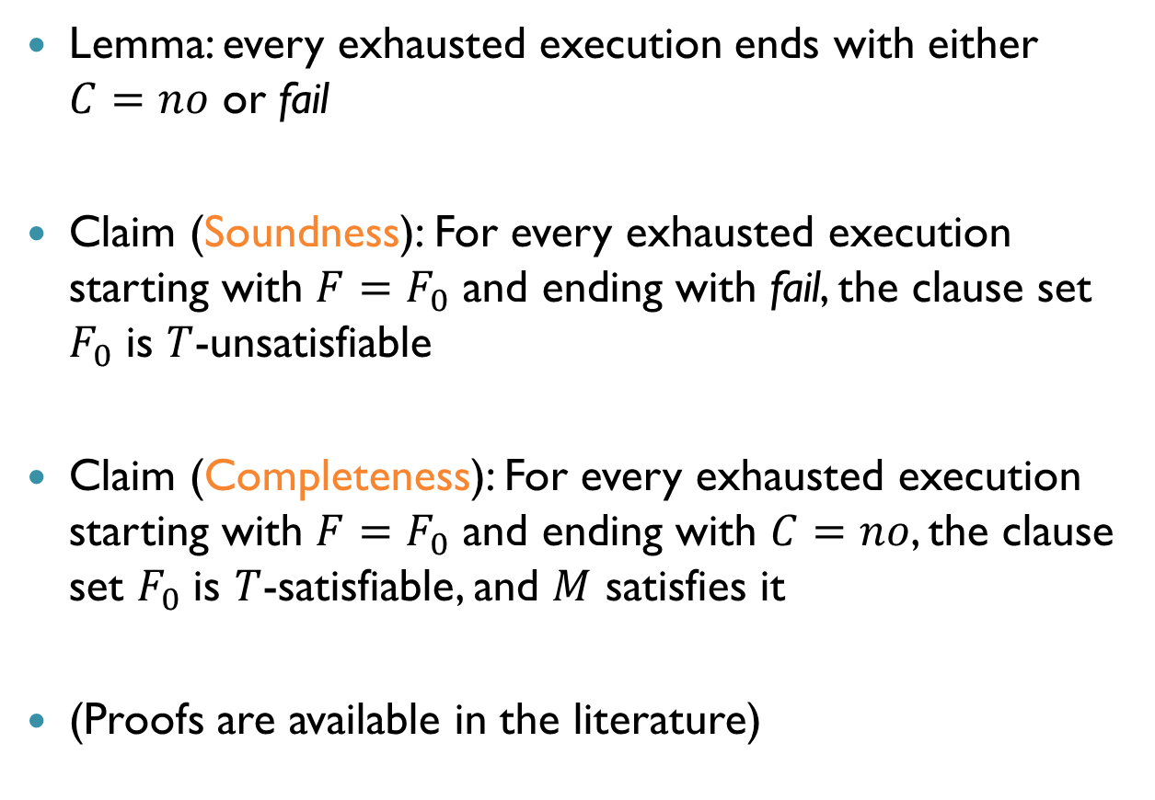
Correctness of DPLL(T) (cnt’d)
Lemma: every exhausted execution ends with either $C=no$ or fail
Claim (Soundness): For every exhausted execution starting with $F=F_{0}$ and ending with fail, the clause set $F_{0}$ is $T$-unsatisfiable
Claim (Completeness): For every exhausted execution starting with $F=F_{0}$ and ending with $C=no$, the clause set $F_{0}$ is $T$-satisfiable, and $M$ satisfies it
(Proofs are available in the literature)

Slide 28
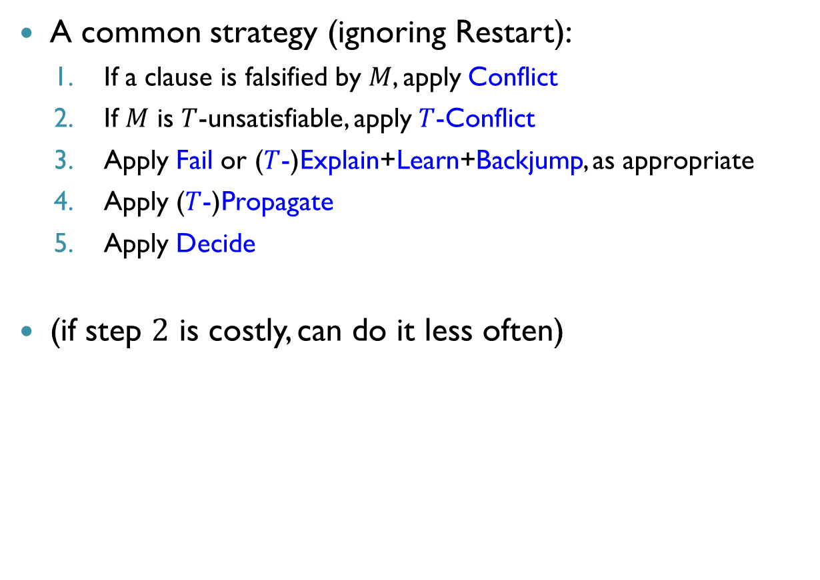
Lazy Approach - Strategies
A common strategy (ignoring Restart):
If a clause is falsified by $M$, apply Conflict
If $M$ is $T$-unsatisfiable, apply $T$-Conflict
Apply Fail or ($T$-)Explain+Learn+Backjump, as appropriate
Apply ($T$-)Propagate
Apply Decide
(if step $2$ is costly, can do it less often)

Slide 29
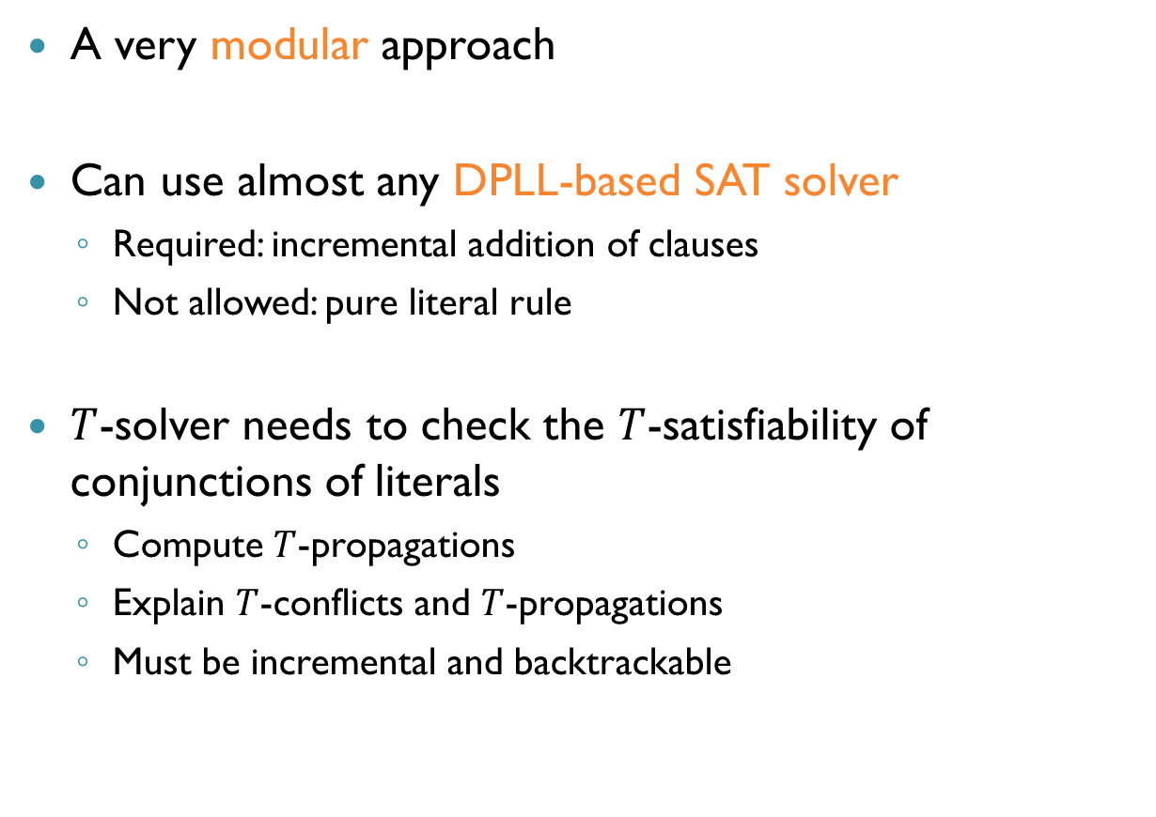
Implementing DPLL(T)
A very modular approach
Can use almost any DPLL-based SAT solver
Required: incremental addition of clauses
Not allowed: pure literal rule
$T$-solver needs to check the $T$-satisfiability of conjunctions of literals
Compute $T$-propagations
Explain $T$-conflicts and $T$-propagations
Must be incremental and backtrackable

Slide 30
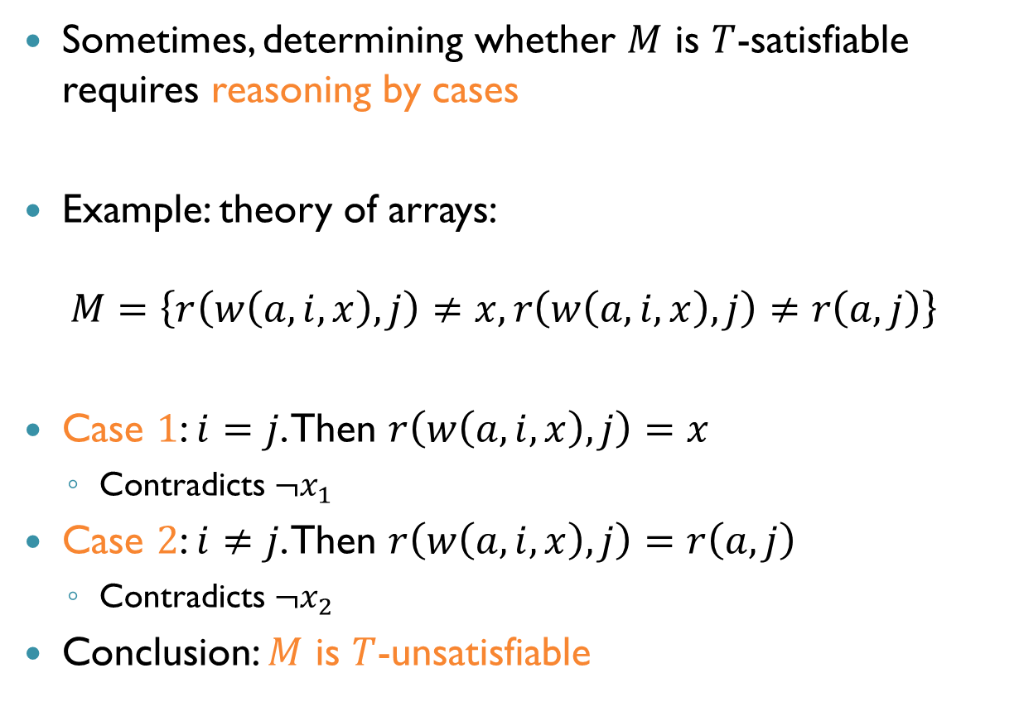



$T$-Solvers: Reasoning by Cases
Sometimes, determining whether $M$ is $T$-satisfiable requires reasoning by cases
Example: theory of arrays:
$$M=\left\{r\left(w\left(a,i,x\right),j\right)≠x, r\left(w\left(a,i,x\right),j\right)≠r\left(a,j\right)\right\}$$
Case $1$: $i=j$. Then $r\left(w\left(a,i,x\right),j\right)=x$
Contradicts $¬x_{1}$
Case $2$: $i≠j$. Then $r\left(w\left(a,i,x\right),j\right)=r\left(a,j\right)$
Contradicts $¬x_{2}$
Conclusion: $M$ is $T$-unsatisfiable
$$¬x_{1}$$
$$¬x_{2}$$

Slide 31
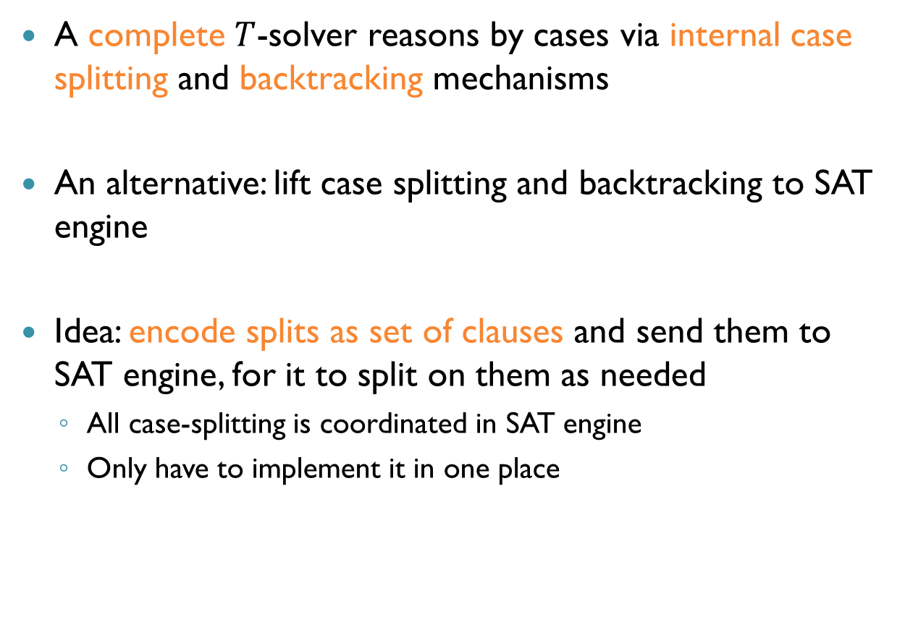
Case Splitting
A complete $T$-solver reasons by cases via internal case splitting and backtracking mechanisms
An alternative: lift case splitting and backtracking to SAT engine
Idea: encode splits as set of clauses and send them to SAT engine, for it to split on them as needed
All case-splitting is coordinated in SAT engine
Only have to implement it in one place

Slide 32

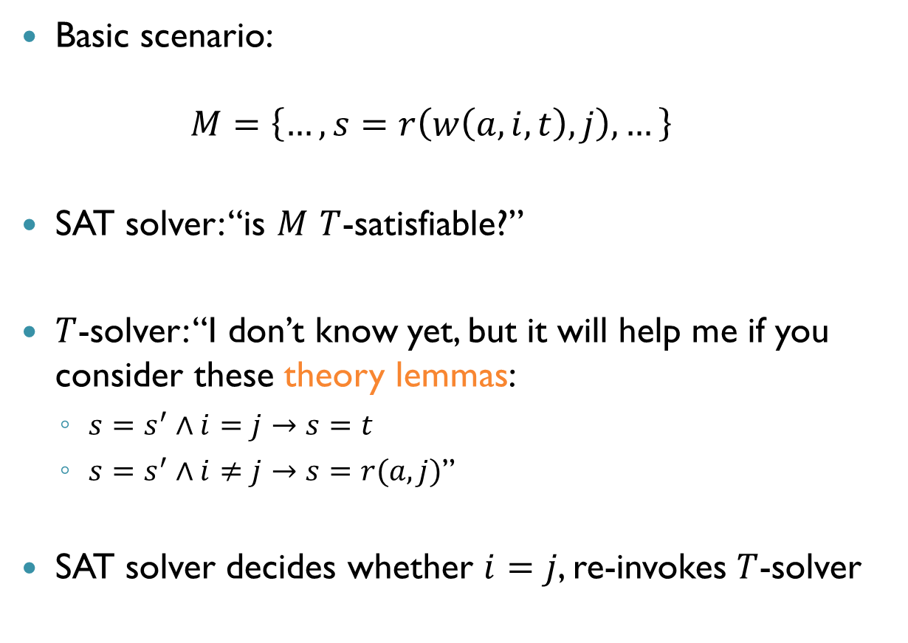
Splitting on Demand
Basic scenario: $M=\left\{…, s=r\left(w\left(a,i,t\right),j\right),…\right\}$
SAT solver: “is $M$ $T$-satisfiable?”
$T$-solver: “I don’t know yet, but it will help me if you consider these theory lemmas:
$s=s^{′}∧i=j→s=t$
$s=s^{′}∧i≠j→s=r(a,j)$”
SAT solver decides whether $i=j$, re-invokes $T$-solver
$$s′$$

Slide 33
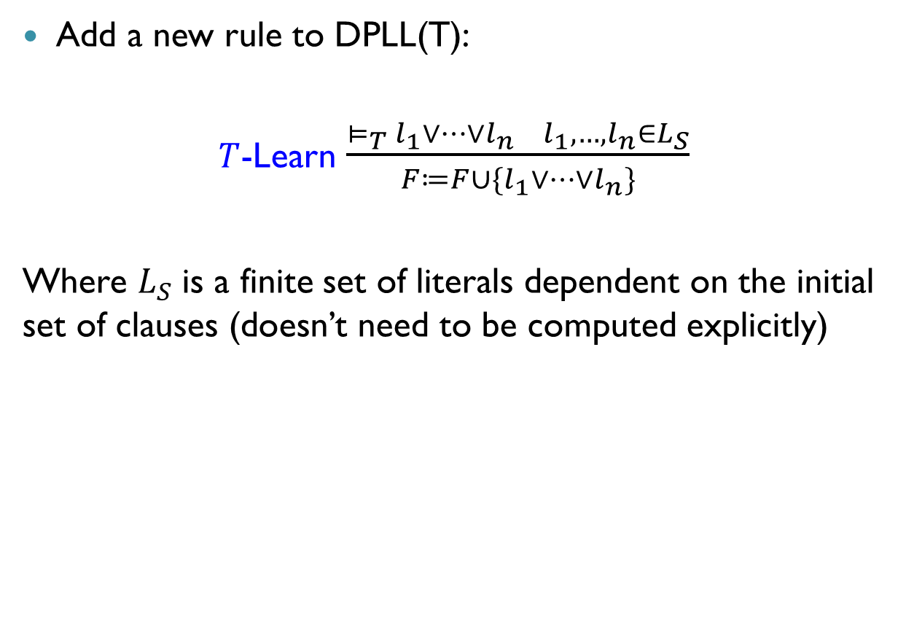
Modeling Splitting on Demand
Add a new rule to DPLL(T):
$T$-Learn $\frac{⊨_{T}{ l}_{1}∨…∨l_{n} l_{1},…, l_{n}∈L_{S}}{F≔F∪\{l_{1}∨…∨l_{n}\}}$
Where $L_{S}$ is a finite set of literals dependent on the initial set of clauses (doesn’t need to be computed explicitly)

Slide 34
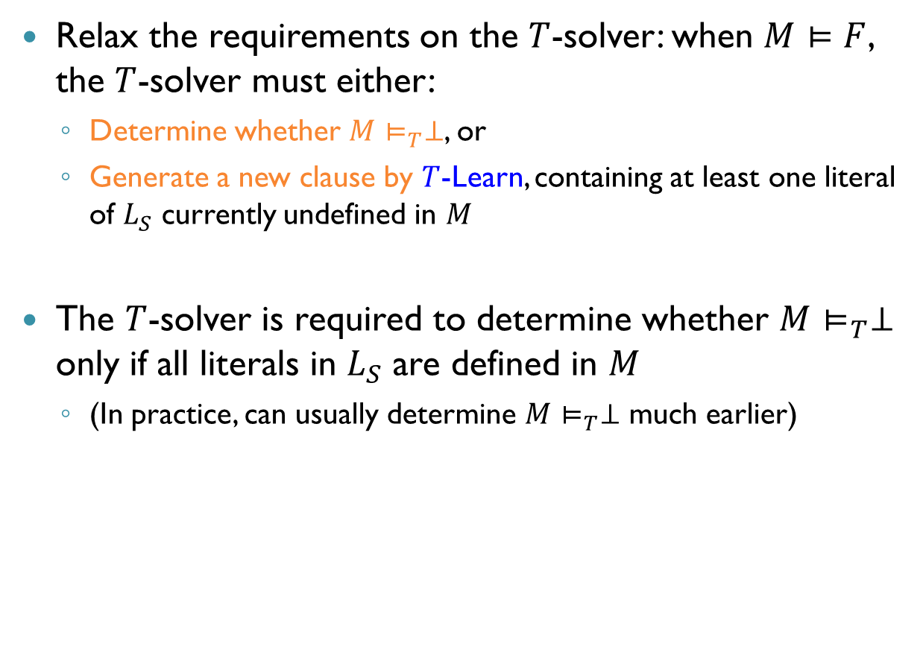
Modeling Splitting on Demand (cnt’d)
Relax the requirements on the $T$-solver: when $M⊨F$, the $T$-solver must either:
Determine whether $M⊨_{T}⊥$, or
Generate a new clause by $T$-Learn, containing at least one literal of $L_{S}$ currently undefined in $M$
The $T$-solver is required to determine whether $M⊨_{T}⊥$ only if all literals in $L_{S}$ are defined in $M$
(In practice, can usually determine $M⊨_{T}⊥$ much earlier)

Slide 35

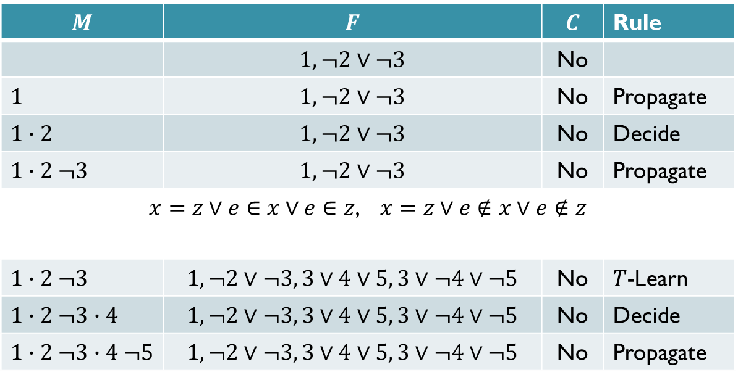





Example: Theory of Finite Sets
$$\left(x=y∪z\right)∧(y≠∅∨x≠z)$$
$$x_{1}$$
$$¬x_{2}$$
$$¬x_{3}$$
$$M$$ | $$F$$ | $$C$$ | Rule
 | $$1, ¬2∨¬3$$ | No
$$1$$ | $$1, ¬2∨¬3$$ | No | Propagate
$$1∙2$$ | $$1, ¬2∨¬3$$ | No | Decide
$$1∙2 ¬3$$ | $$1, ¬2∨¬3$$ | No | Propagate
$x=z∨e∈x∨e∈z$, $x=z∨e∉x∨e∉z$
$$1∙2 ¬3$$ | $$1, ¬2∨¬3, 3∨4∨5, 3∨¬4∨¬5$$ | No | $T$-Learn
$$1∙2 ¬3∙4$$ | $$1, ¬2∨¬3, 3∨4∨5, 3∨¬4∨¬5$$ | No | Decide
$$1∙2 ¬3∙4 ¬5$$ | $$1, ¬2∨¬3, 3∨4∨5, 3∨¬4∨¬5$$ | No | Propagate
$$x_{4}$$
$$x_{5}$$

Slide 36

Example: Theory of Finite Sets (cnt’d)
At this point, the $T$-solver can deduce: $e∈x⇒e∈y∪z⇒e∈y⇒e∈∅⇒⊥$
This enables the application of $T$-Conflict with clause: $x≠y∪z∨y≠∅∨x=z∨e∉x∨e∈z$

Slide 37
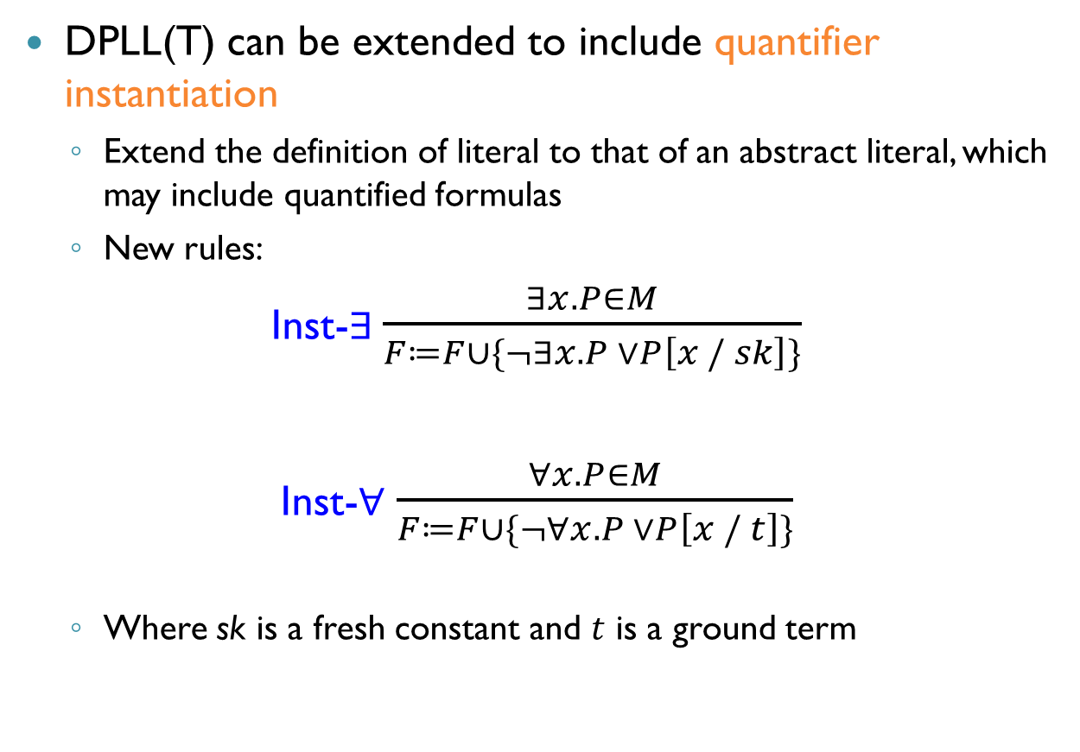
Quantifiers
DPLL(T) can be extended to include quantifier instantiation
Extend the definition of literal to that of an abstract literal, which may include quantified formulas
New rules:
Inst-$∃$ $\frac{∃x.P∈M}{F≔F∪\{¬∃x.P ∨P\left[x / sk\right]\}}$
Inst-$∀$ $\frac{∀x.P∈M}{F≔F∪\{¬∀x.P ∨P\left[x / t\right]\}}$
Where sk is a fresh constant and $t$ is a ground term
רגע של עברית: סקולמיזציה, שם עצם ללא משתנים

Slide 38
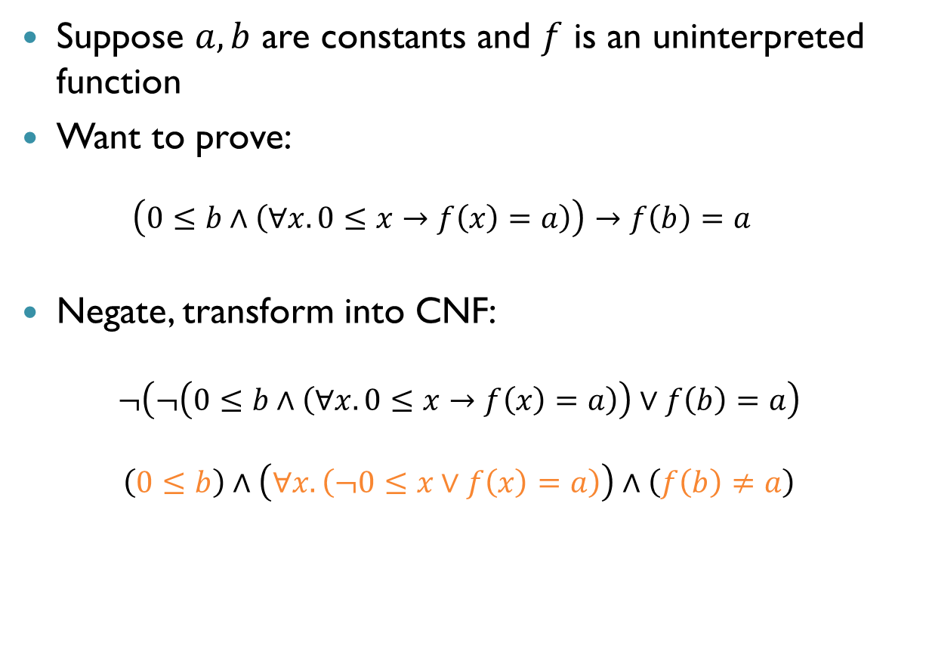
Quantifiers: Example
Suppose $a, b$ are constants and $f$ is an uninterpreted function
Want to prove: $\left(0≤b∧\left(∀x.0≤x→f\left(x\right)=a\right)\right)→f\left(b\right)=a$
Negate, transform into CNF:
$$¬\left(¬\left(0≤b∧\left(∀x.0≤x→f\left(x\right)=a\right)\right)∨f\left(b\right)=a\right)$$
$$\left(0≤b\right)∧\left(∀x.\left(¬0≤x∨f\left(x\right)=a\right)\right)∧\left(f\left(b\right)≠a\right)$$

Slide 39
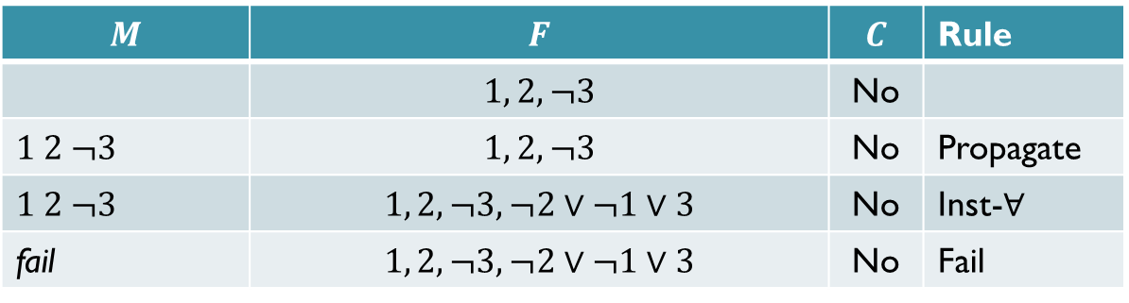




Quantifiers: Example (cnt’d)
$$\left(0≤b\right)∧\left(∀x.\left(¬0≤x∨f\left(x\right)=a\right)\right)∧\left(f\left(b\right)≠a\right)$$
The negation is UNSAT, so original formula is valid
$$x_{1}$$
$$x_{2}$$
$$¬x_{3}$$
$$M$$ | $$F$$ | $$C$$ | Rule
 | $$1, 2, ¬3$$ | No
$$1 2 ¬3$$ | $$1, 2, ¬3$$ | No | Propagate
$$1 2 ¬3$$ | $$1, 2, ¬3, ¬2∨¬1∨3$$ | No | Inst-$∀$
fail | $$1, 2, ¬3, ¬2∨¬1∨3$$ | No | Fail

Slide 40
Quantifier Instantiation
Quantifier instantiation is very effective on verification benchmarks
Main difficulty: coming up with the right terms to instantiate
Extensive work on matching techniques (heuristics)

Slide 41
Recap: SMT: Main Challenges
How to solve conjunctions of literals in a theory?
Use theory solvers
How to combine solvers for multiple theories
The Nelson-Oppen method
How to combine a theory solver and a SAT solver
The DPLL(T) framework

Slide 42
Summary
Abstract DPLL(T): an extension of DPLL to work with a theory solver T
SAT solver handles Boolean reasoning
Theory solver handles theory reasoning
Theory solver guides the search via propagations, learning new clauses and (early) conflict detection and analysis
A highly modular approach
Coming up next: theory solvers!

